Slide 1
Life After TAPE 2007 Our Baldrige Journey to Excellence…..
G Mark Montgomery, MD, MMM, CPE
Senior Vice President, Chief Medical Officer
St Joseph Health System
Bryan, Texas
mmontgomery@st-joseph.org

Slide 2
Tim Ottinger, VP Community Relations
St Joseph Health System
Category 3 Lead
National Baldrige Examiner
Reed Edmundson, Administrator Madison, Grimes St Joseph Health Center
St Joseph Health System
Category 2 lead
Charlotte Ferguson, RN
Director Performance Improvement
St Joseph Health System
Category 6 team member, writer
National Baldrige Examiner
Quality Texas Examiner

Slide 3
Beverly Welch, RN
Director Emergency Services
St Joseph Health System
Category 3 team member
Ed Lovas, RN
Director Cardiac Cath lab
St Joseph Regional Hospital
Quality Texas Examiner
Kendall Turton
HR Director
St Joseph Health System
Category 5 Co-lead
Quality Texas Examiner
Debbie Jewell
Director Laboratory Services
St Joseph Regional Hospital
Category 4 team member

Slide 4
SJHS
7+ county service area
350,000 population
Acute care-
275 bed flagship
3 critical access 25 beds each
Long Term Care
2 locations-230 beds
Ambulatory care
55 employed physicians
18 locations
2600 employees

Slide 5
The Way We Were 2003
Average as average can be
Stuck in a rut
“Titanical”
System of silos
214 organizational strategies
Each facility with different mission/vision
Data rich/action poor

Slide 6
Notes:
Discuss why chose baldrige as improvement tool-2003

Slide 7
Journey Begins
2004 Quality Texas
Self Assessment/progress level application
SSM visited
Examiner training
2005-2007 Texas Award level application
2007 TAPE winner
2008-2011 National Baldrige Award application
2010 Baldrige site visit

Slide 8
6 Category Team Structure
VP/CO leaders
7-10 team members
Examiners on each team in charge of writing and corresponding results
Team leaders responsible for communication, process implementation, policy changes
Change agents

Slide 9
Consultants
Initial training
Category teams
Executive team/BOT
Management team
Feedback report review
Category teams
Best practice sharing
Application review
1 in depth review
Site visit preparation
Team member training
Notes:
Never wrote the application

Slide 10
The Way We Are 2013
“Systemized”-ADLI/LeTCI
Single mission/vision focused on “excellent healthcare”
Continuous measurement and improvement
Strategic goal cascade to individual staff
Incorporating LEAN
Studer Group focus on employee engagement

Slide 11
Notes:
Alignment/integration
Moving forward

Slide 12
The Best Baldrige Things
Core competency-values based behavior
“The St Joseph Difference”
Customer Focus-patients and residents
Requirements-convenience, service, quality
Access- “Closer to Home”
Focus on excellence
Mission, vision
PI program

Slide 13
The Best Baldrige Things
“Every process is perfectly designed to get the results it gets”
ADLI
“Baldrige makes you look hard at your processes.”
LeTCI
“I had never used benchmarking and doing so against Baldrige winners gave us a great avenue to best practice.”

Slide 14
The Best Baldrige Things
Internal expertise development
Baldrige, PI, patient safety, “square root N”
2-3 Texas and National examiners per year, VPs and directors
The application
Best single source document describing SJHS
“The Organizational Profile helped me to understand Strategic Marketing advantages”

Slide 15
Category by Category
Leadership communication cascade
Policy summary sheets
Newsletters
Team member minute
“The best thing was that it got us started on cascading communication.”
Senior leader rounding
Formal/informal
Staff/physicians
Alignment of community benefit program with Mission
Community wellness
“It helped us to focus on wellness and our partnerships with Social Welfare organizations, for the first time we understood we cannot serve the needy of the Brazos Valley by ourselves.”

Slide 16
Category by Category
Strategy development and deployment
“Baldrige helped to get us in an aligned process that ensures the money is there to complete the strategy”
Goal cascade
“For the first time St Joseph System Strategies were cascaded down to the front line of all of our facilities.”
Measurable strategic goals and performance projections

Slide 17
Category by Category
Customer service
“Behavior standards aligned to values”
Focus groups-VOC
Top box focus
Complaint management /service recovery
Let us know before you go cards
Unit leader rounding
White boards, OR tracking board, PIN system

Slide 18
Category by Category
MEASUREMENT
Scorecards
Performance review
Communication boards
“Baldrige gave us the process to establish transparent goals, action plans and results which are prominently displayed where staff and our customers can easily access.”
MDI boards

Slide 19
Category by Category
Workforce
Everyone created equally
“We began to think about the importance of engagement of our employees and started Personal Development plans”
On boarding
Leadership development
Reward and recognition
Champions of care
Physician recognition values based
Individual development
Career development/succession planning

Slide 20
Category by Category
PROCESS
Process design
“Baldrige taught me that to achieve a challenging goal one must improve process.”
“To improve processes, you must have process users in the room with leadership support”
PI methodology
PIE/PDCA
LEAN
Reliability Science
“Baldrige and Studer together helped all of us to realize Healthcare is a lifelong learning process, as Sister Gretchen would say there is no end to getting better.”

Slide 21
Results
32 out of 105
Top decile
Baldrige award winners
Sustainment

Slide 24
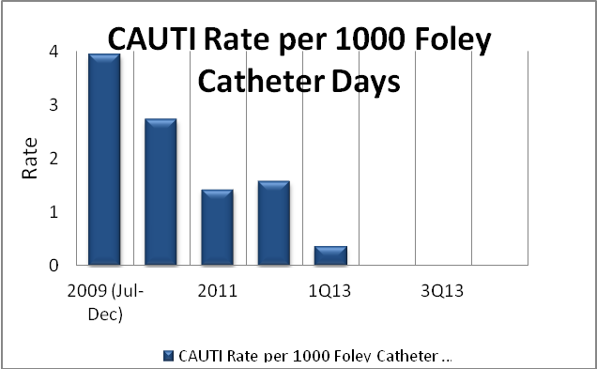

Slide 26
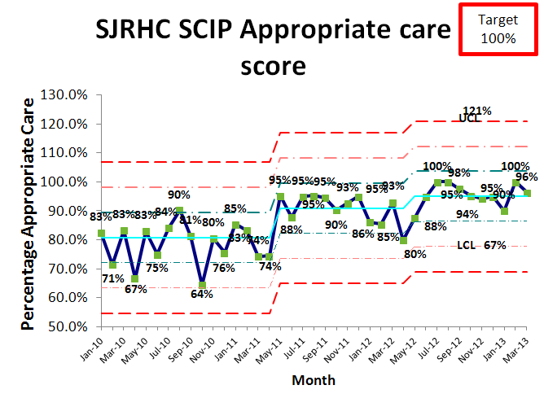
2007-82%
2008-83%
2009-84%

Slide 27
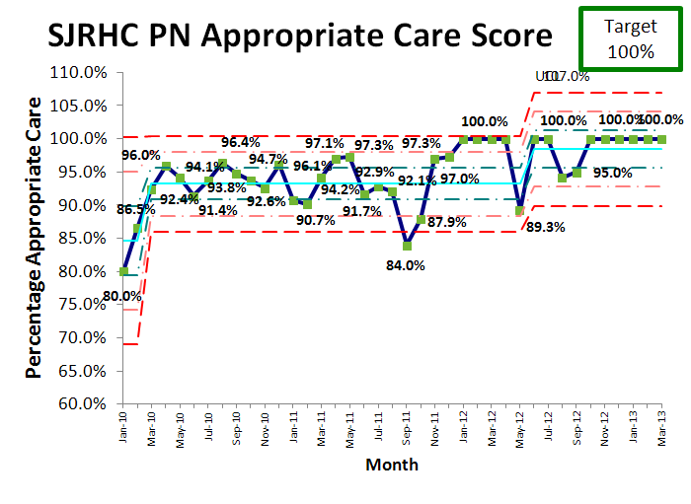
2007-65%
2008-82%
2009-83%

Slide 28
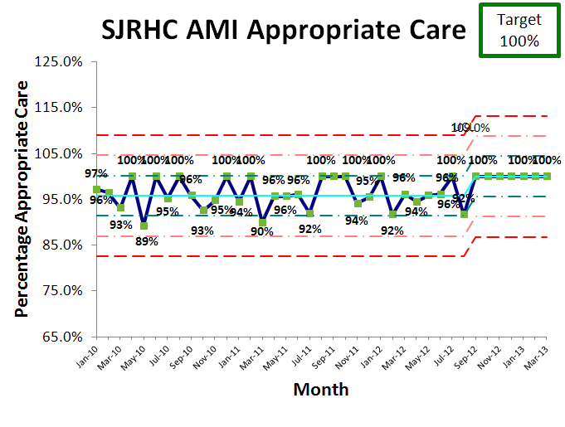
2007-86%
2008-92%
2009-95%

Slide 29
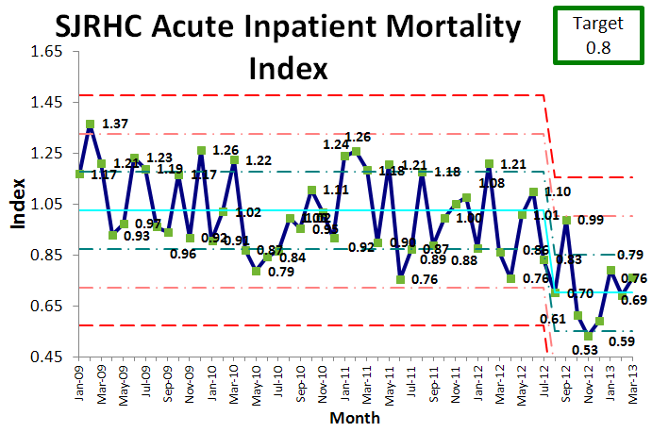

Slide 32
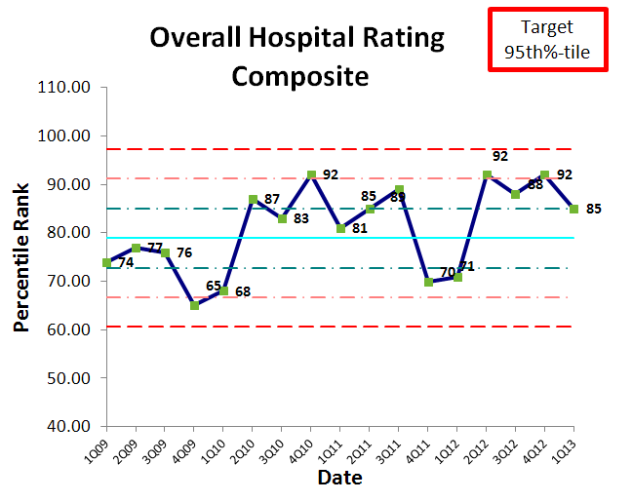

Slide 33
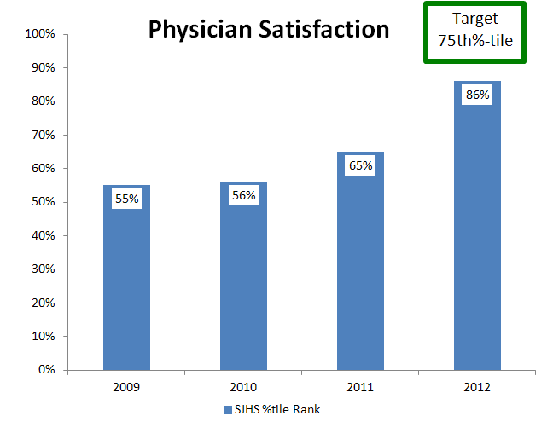

Slide 38
Results
Health Grades Five Star Rated
Total Knee Replacement (2008-2012)
Total Hip Replacement (2011-2012)
Hip Fracture Repair (2011-2012)
Back and Neck Surgery (except Fusion) (2006-2012)
Back and Neck Surgery (Fusion) (2009-2012)
Treatment of Stroke (2012)
Treatment of Pneumonia (2012)
Carotid Surgery (2007-2012)

Slide 39
Results
Health Grades State and National Rankings
Ranked #1 in Texas for Overall Orthopedic Services (2011-2012)
Ranked among America’s 100 Best Hospitals for Overall Orthopedic Services (2012)
Ranked #7 in Texas for Joint Replacement (2012)
Ranked among America’s 100 Best Hospitals for Joint Replacement (2012)
Ranked #5 in Texas for Spine Surgery (2012)
Ranked among America’s 100 Best Hospitals for Joint Replacement (2012)
Ranked among the Top 10% in the Nation for Treatment of Stroke (2012)
Outstanding Patient Experience Award- top 10% (2009-2012)
Notes:
Most all results solid top quartile; many in top decile top decile; more each year.

Slide 40
Results
Stroke AHA GWTG
Bronze Performance Award 2010
Silver Performance Award 2010
Gold PLUS Performance Award 2011, 2012
AMI AHA GWTG
Silver Performance Award 2011
Gold Performance Award 2012

Slide 41
What about the Docs?
Need to know the goal-top decile performance
Focus on evidence based practice and service (AIDET)
Keep informed of progress
Make it easy to do the right thing
More than 100 hours of physician participation in PI activities for 2013 to date

Slide 42
Learning
Don’t wait until your ready
It takes longer than you think
Requires leadership passion for excellence
You don’t know what you don’t know until someone tells you
Develop internal expertise
Forget the award-it’s the reward that’s important

Slide 43
Learning
“We learned how difficult it was to drive change to the front line and sustain it”
“helped focus us on how we made improvements that reached from top to bottom in the organization”
“It identified and developed leaders in the organization”
“without top leadership buy-in, it was near impossible to make progress with Baldrige”
“We realized the rich resource we had in our people”

Slide 44
More Quotes
“Baldridge gave us a sense of purpose and an organized structure within which to work. Additionally, our accomplishments in meeting Baldridge criteria and in being recognized by Baldridge gave me a great sense of pride!”
“It taught us to look at ourselves, the organization, the role we play in the organization, the role the organization plays in the community, and it fostered an environment that lead to maturation and growth of a myriad of process improvement initiatives that made us a better organization.”

Slide 45
“It really was all about the journey - working as a team to connect the dots in all of the categories.
It connected us and our work to our mission and values.”

Slide 46
Questions? mmontgomery@st-joseph.org

