Slide 1
Pursuit of a Vision

Slide 2
St. David’s Pursuit
Organizational context
What our pursuit has looked like
Lessons learned
Results

Slide 3
St. David’s Pursuit
Organizational context
What our pursuit has looked like
Lessons learned
Results

Slide 4
Vision:
To be the Finest Care and Service Organization in the world
Mission:
To Provide Exceptional Care to Every Patient, Every Day
with a Spirit of Warmth, Friendliness and Personal Pride
Values:
Goals:
I ntegrity
C ompassion
A ccountability
R espect
E xcellence
Exceptional Care
Customer Loyalty
Financial Strength

Slide 5
A unique business model
A unique public\private partnership benefitting all partner interests
Since the formation of St. David’s HealthCare, the Partnership has reinvested over $700 million in the hospitals.
  Without raising a dollar from the community
  Without borrowing a dollar
Like tax-exempt hospital systems, St. David’s HealthCare hospitals are held to the highest community benefit standards.
  Tax-exempt status is dependent on hospital operations, not the Foundation
    Open physician staff
    Serving the uninsured and indigent
    Meeting the community healthcare needs
Foundation cannot raise money to benefit hospitals.
Notes:
4

Slide 6
Forces for integration
St. David’s
HCA
St. David’s HealthCare
Freestanding healthcare system
Limited geographic coverage
Limited access to capital
Highly recognized, respected name
Vertical integration
  Primary Care, Rehab, SNF, psych, etc
Sub-optimal negotiating position with payors
  While HMO enrollment sky-rocketed
Part of nation’s largest health care firm
Geographically dispersed facilities
  No central presence
  Relatively weak market position
Lack of vertical integration
Lack of centralized management
Managed care pressure
Improved Access to Capital & Liquidity
Continuity of Mission + HCA Expertise
Service Growth
Financial strength to ensure leading-edge technology, advanced information systems and modernized facilities
Improved Profitability
  Centralized management
  Economies of scale
  Operational synergies

Slide 7
Formation of St. David’s HealthCare
Community
HCA
Epic
HealthTrust
Community
1993
St. David’s
Med Ctr
St. David’s South Austin Med Ctr
St. David’s Round Rock Med Ctr
St. David’s North Austin Med Ctr
St. David’s Georgetown Hosp
1994
HealthTrust
1995
HCA
1996
HCA /
St. David’s
1998
St. David’s Partnership
2006
St. David’s HealthCare

Slide 8
St. David’s Healthcare: History and Highlights
1924 | St. David's Episcopal Church works with 5 physicians to purchase original St. David’s Hospital
1955 | New St. David’s Hospital constructed at current location on 32nd Street
1996 | St. David’s Hospital and HCA contribute local assets to a joint venture partnership St. David’s Foundation is created, a joint owner of St. David’s HealthCare with HCA
2006 | St. David’s HealthCare acquires St. David’s Georgetown Hospital
2008 | St. David’s Medical Center establishes Texas Cardiac Arrhythmia Institute and The NeuroTexas Institute Opened Urgent Care Centers in Pflugerville and Kyle
2009 | St. David’s North Austin Medical Center opens St. David’s Women’s Center of Texas St. David’s HealthCare acquires Austin Heart physician group
2010 | St. David’s HealthCare completes acquisition of Heart Hospital of Austin Opened Urgent Care Center in Round Rock
2011 2012 | St. David’s North Austin Medical Center establishes the Texas Institute for Robotic Surgery St. David’s South Austin Medical Center announces $72M expansion. Opened Free-standing Emergency Departments in Bee Cave and Pflugerville Opened Free-standing Emergency Department in Bastrop Completed acquisition of Central Park Surgery Center

Slide 9



St. David’s HealthCare Organizational Structure
St. David’s
Medical Center
St. David’s South Austin Medical Ctr
St. David’s North Austin Medical Ctr
St. David’s
Round Rock Med Ctr
St. David’s
Medical Group
St. David’s
Georgetown Hospital
S. Austin Surgery Ctr (SurgiCare)
St. David’s
Women’s Ctr of Texas
Oakwood
Surgery Center
St. David’s Heart & Vascular
Heart Hospital
of Austin
FSED – Bee Cave
Texas Institute for Robotic Surgery
St. David’s Primary Care
FSED - Bastrop
St. David’s
Rehabilitation Hospital
St. David’s Specialty Practices
North Austin
Surgery Center
Bailey Square
Surgery Center
Central Texas Medical Center
(Clinical Affiliate)
FSED - Pflugerville
Central Park
Surgery Center
St. Mark’s Medical Center
(Clinical Affiliate)
Fertility
Surgery Center
Hill Country Memorial Hospital
(Clinical Affiliate)
TCAI
NTI

Slide 10
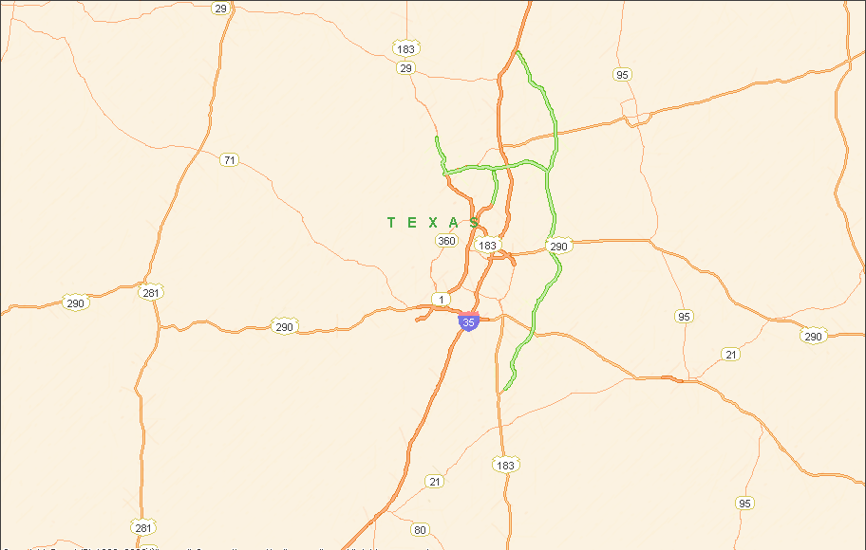
Geographic footprint of St. David’s HealthCare
 | 6 Comprehensive Hospitals
 | 1 Rehabilitation Hospital
 | 6 Surgery Centers
 | 4 Urgent Care Centers
 | 76 Physician Offices
 | 3 Freestanding ERs
 | 3 Clinical Affiliate Hospitals
Georgetown
St. David’s Georgetown Hospital
St. David’s Round Rock
Medical Center
Round Rock
St. David’s North
Austin Medical Center
Pflugerville
Heart Hospital of Austin
Lakeway
Austin
St. David’s Medical Center
Hill Country Memorial Hospital
St. David’s Rehabilitation Hospital
Fredericksburg
St. David’s South Austin Medical Center
Circle C
Wimberley
Kyle
St. Mark’s Medical Center
La Grange
Central Texas Medical Center
San Marcos
Notes:
Add animation

Slide 11
Organizational Summary
7 Hospitals
  1 Rehabilitation Hospital
  1 Heart Hospital
6 Surgery Centers
3 Freestanding Emergency Centers
4 Urgent Care Centers
76 Physician Offices
3 Clinical Affiliate Hospitals
Market Share (Adult/Neonatal): 47%
Admits: 65,000 (4% CAGR)
ER Visits: 298,000 (4% CAGR)
Births: 15,000 (4% CAGR)
NICU Admits: 1,800 (9% CAGR)
Surgeries: 74,000 (2% CAGR)
Open Heart Surgeries: 940 (8% CAGR)
Net Revenue: $1.27B (9% CAGR)
EBITDA: $305M (10% CAGR)
Margin: 24%
1,376 Beds
Primary Service Area Spans Five Counties and Covers 4,220 sq miles
40% Commercial
36% Medicare
14% Medicaid
10% Self-Pay/Charity
7,500 Employees
  3rd largest private employer in Austin
2,275 Physicians on Staff

Slide 12
Market Demographics
Population of 1,871,850
Rapid population growth: 2.3% 5-yr CAGR (US: 0.8%)
  Fastest growing city in the fastest growing state in the nation
    1,000 people move to Texas every day; 150 people move to Austin every day
  Austin: 3rd fastest growing city in America with a population of more than 100,000 (3.8% growth); Round Rock: 2nd fastest
  Greatest growth in Williamson (north) and Hays (south) counties
Young but aging population
  Median Age: 34.4 (US: 36.7)
  65+ Population: 6.1% 5-yr CAGR; 26% of market growth (US: 3.0%)
Increasing inpatient utilization: 1.1% YOY (TX: 0.5%)
High but declining commercial payer mix
  33.5% commercial, 36.2% Medicare, 16.5% Medicaid, 9.4% Self-Pay
    2nd highest rate of commercial volume in Texas
  Population shifting rapidly to Medicare
    Commercial volume was the predominant payer only two years ago
    Medicare is 95% of inpatient utilization growth over last three years
Notes:
Payor mix is for year ending Q1 2012. Inpatient utilization increase is for year ending Q1 2012 vs year ending Q1 2011
Austin market is 33.5% commercial, North Texas / DFW is 33.8%, now in 3rd place is Houston with 32.7%

Slide 13
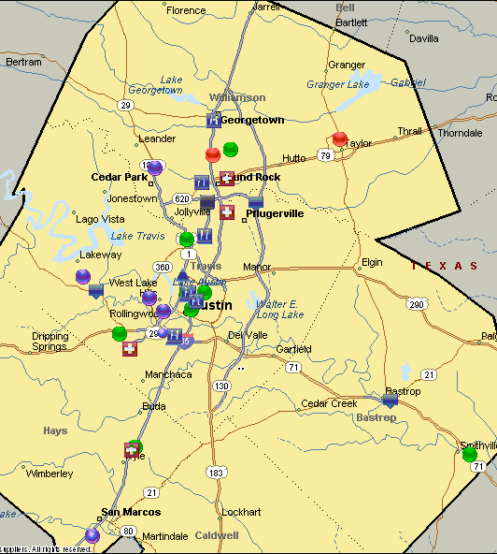
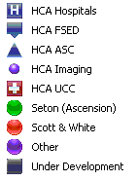
Competitive Environment
Despite rapid population growth, hospital development has outpaced demand
Eleven new competitor hospitals (1,027 additional beds) have entered market since 2005 - leading to a surplus of 939 beds in Austin (3,310 total)
Seton Healthcare Family (Ascension)
10 Acute Care Hospitals (excl. 2 hospital JVs)
1,544 Acute Beds in PSA
1 Rehab Hospital JV
1 Psych Hospital
147 Behavioral Health Beds
4 Ambulatory Surgery Centers
Scott & White
11 Acute Care Hospitals
(3 in PSA)
126 Acute Beds in PSA
5 Ambulatory Surgery Centers
Health Plan: 2k MDs, 50k enrollees
Network of 17 urgent, specialty & primary care clinics in Williamson County
Other
3 Physician JV Hospitals
1 JV Hospital (20% Seton:80% CHS)
3 HCA Clinical Affiliates
(1 in PSA)
2 Rehab Hospitals (excl. Seton JV)
1 Physician JV Hospital in Development

Slide 14
St. David’s Pursuit
Organizational context
What our pursuit has looked like
Lessons learned
Results

Slide 15
Where we started
Began using the Baldrige criteria in 2003 when a new CEO arrived.
  He had successfully used the framework in his prior organization in Kentucky.
Beginning in 2005 several internal people were trained as state examiners with Texas Quality Foundation.
Began just asking questions around leadership, strategic planning, customer (patient) focus, data use, workforce and process.
Began to examine where we had variability among our operations
Challenged ourselves to attain higher and higher levels of results.
Did not talk about the Baldrige award much….
  but grew keenly aware of the questions
  how we assessed our approaches,
  Assessed our deployment throughout the organization
  Examined the alignment with our mission and overarching three goals.
Applied formally to the state in 2008 and were a recipient of the Texas Award for Performance Excellence that year.

Slide 16
Baldrige – Since 2008
First of all…. We took a deep breath
We were told … “Congratulations on receiving the TAPE award…. That is like winning the 3A state high school football championship. Now you are going to play to get in the super bowl against the Dallas Cowboys!”
Senior leaders decided that we would continue to pursue the use of the criteria to:
  Improve the care we provide to patients
  Improve the results of the organization
Evaluated and used the feedback reports to glean objective insights into the organization
Submitted formal applications in 2009, 2010, 2011 and most recently 2013
Spent time educating the organization’s leaders in the criteria
  Senior executives attended QUEST
  Met with Baldrige recipient CEO’s and leaders
  Conducted Baldrige criteria training for all mid-level managers
Worked with several consultants and Baldrige experts
  Leveraged style and deeper knowledge
Looked for benchmark processes within and outside of the healthcare industry

Slide 17
Baldrige – Pursuit of a Vision
Senior most leader – while attending QUEST identified several things we needed to do better
  Share knowledge throughout the organization
  Understand our patients, physicians and staff better
  Using benchmarks to drive higher levels of results
  Formalize the informal – identify processes more clearly
  Standardize approaches across the enterprise
  Deepen the understanding of the criteria questions into the organization
We needed a vision
  Conversation with CEO of Atlanticare
  Historically we were a mission driven organization
  Created the vision statement through dialogue as a part of the strategic planning process – “to be the finest care and service organization in the world”
  Communicated the vision formally through the organization

Slide 18

Aligning and Executing for Results
Vision
To be the finest care and service organization in the world
Mission
Exceptional care
Every patient
Every day
Goals
Exceptional Care
Financial Strength
Customer Loyalty
Strategic Planning
Annual Planning Process
Environmental Assessment
Assumptions
Strategies \ Tactics
Action Planning\Execution
Cascade to facilities
Quarterly Reviews
Capital Investment
Physical Plant
Technologies
Process Mgmt
Clinical
Operational
Results
Dashboard
Clinical
Financial
Market
Service
Measurement \ Evaluation
Monthly Operations
Quarterly Reviews
Leadership Evaluation
Market\Facility Committees
Human Resource Mgmt
Recruitment\Retention
Leadership Development
Reward\Recognition
Physician Relationship Mgmt
Sales Team
One Call
Medical Staff
Foundational Systems
Information Technology Budgeting \ Accounting
Regulatory Compliance Supply Management
Ethics and Compliance Productivity Systems

Slide 19
SDH Annual Planning Cycle - standardized
Complete Environmental Assessment
Obtain
Stakeholder Input
Brief Boards at
Governance Retreat
Conduct System-Wide Planning Retreat
JAN - FEB
MAR - APR
MAY
JUNE
Analyze Key Market & Performance Trends
Solicit Stakeholder Input
Assemble Market Intelligence
Discuss Key Market & Performance Trends
Gain External Perspectives of Industry Trends
Present System Update
Provide Expert Perspectives of Industry Trends
Define Key Challenges & Advantages
Develop System-Wide Strategic Plan
Deploy & Implement
Approve System-Wide Budget and Plan
Approve Entity
Budgets
Finalize System-Wide Action Plan
Develop Entity Action Plans
DEC
NOV
OCT
JULY - SEPT
Present Annual Budget
Present Annual Business Plan
Assess and Approve Entity-Specific Budget Expectations
Consolidate Entity Budgets and Plans
Integrate Entity Action Plans into System-Wide Action Plan
Establish System-Wide Performance Projections
Review Performance & Market Trends
Assess Entity Tactics
Establish Performance Projections

Slide 20
St. David’s Pursuit
Organizational context
What our pursuit has looked like
Lessons learned
Results

Slide 21
Baldrige – Key lessons learned
Simplify versus boast about the organization
  Focus on the organizational profile and it’s implications for the entirety of the application
Conducted “deployment” checks
  As a part of anticipation of a site visit
  Identified key themes and potential site visit issues
  The deployment checks uncovered additional gaps deeper into the organization
  Get a real sense of the deployment before the site visit
  Similar to ongoing readiness for Joint Commission
Senior executive team created action plans to address potential gaps
  Built tracking into normal operations and strategic planning process
Move from an annual application writing exercise to embedding the process into the culture and fabric of the organization

Slide 22
Opportunities
Clarify key requirements and engagement factors
Criteria: Identification of key requirements/engagement factors; integration of key requirements/engagement factors into strategy & operations
Employees
Physicians
Patients
Community
Further work on data aggregation
Criteria: Integration
Complaints, discharge phone calls logged at each facility in different systems
VOC from rounding compiled at unit level
NRC not widely shared
Separate reporting process for SDHMG patient satisfaction
SDHMG not included in quality reviews

Slide 23
Opportunities
Performance Measurement
Criteria
  Measures that indicate progress relative to strategic plan/action plans
  Process and outcome measures for all key work processes
  Alignment of key performance indicators across organization
Limited alignment between Performance Dashboard and action plan measures
Different key measures monitored at each facility
No process for hardwiring goal of national top 5%
Integration of evolving physician medical group
Criteria: Deployment, integration
Separate processes
  Training & development
  Employee health
  Reporting of key measures
  Assessing employee engagement
  Strategic planning process
  Limited standardized process and clinical measures

Slide 24
Standardization across Multiple facilities
Criteria: Consistent deployment or different by design
Senior leader standard work
  Onboarding, especially interactions with senior leaders
  Senior leader participation in round-ups & Employee Advisory Group
  Senior leader role in sharing employee engagement results
  Facility processes for following up on HACs and core measure fall-outs
Process for using physician engagement survey results
Patient Safety Council/Patient Safety Team

Slide 25
Priorities
OFI | Action
Measurement Alignment | Link Strategic Plan to Performance Dashboard to key facility performance measures
Process Improvement | Develop standard process/tools; train leaders
Key Patient & Community Requirements | Establish process to determine key requirements
Key Workforce Engagement Factors | Establish process to determine key employee and physician engagement factors
Integration of SDHMG | Incorporate SDHMG into quality reporting process

Slide 26
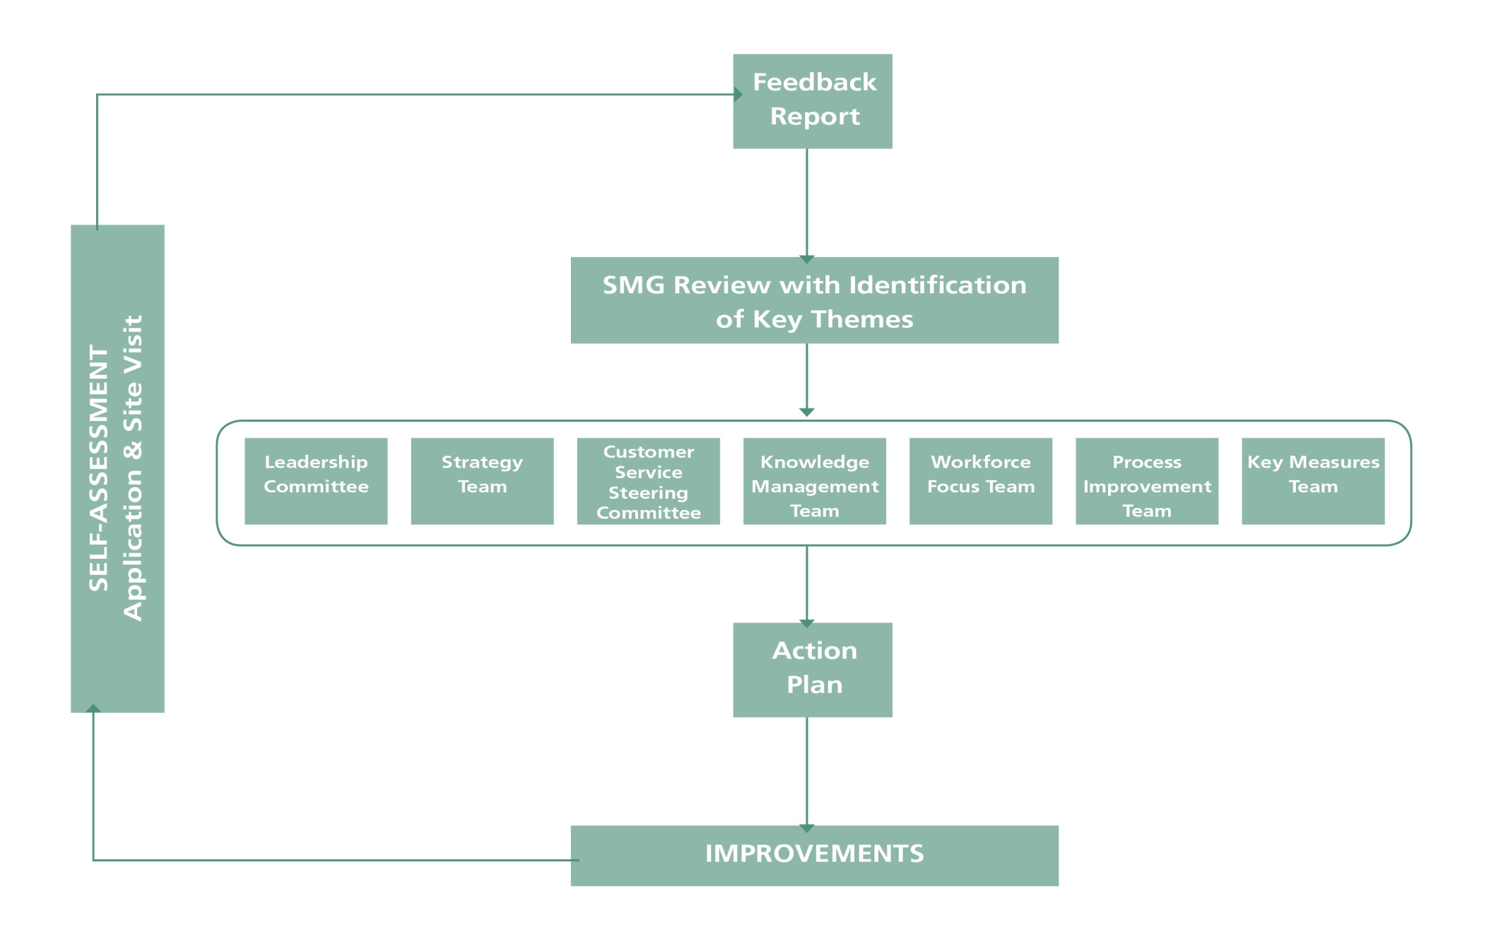
Performance Excellence Cycle
Benchmarked Poudre Valley Health System in Fort Collins, CO

Slide 27
Improving the application “story”
Over the years, we have learned about how to precisely communicate our story
Lessons learned….
The application is an invitation, not an encyclopedia that contains every single nuance of the organization
The goal of the application is to obtain Accurate, actionable feedback to help the organization achieve it’s vision either through….
  Self-assessment
  External assessment by highly trained team of examiners
The organizational profile sets the stage for everything else… it is the “lens” by which the examiner team evaluates your organization
While there may be great leaders in the organization, not all of us are great writers
The understanding of the criteria needs to be expanded to understand the linkages between all of the criteria categories
The examiner team will typically read the profile and then glance at the results sections of the application first to get a sense of the organization

Slide 28
Main Healthcare Service Offerings [P.1a(1)]
Baldrige definition: Services that your organization offers in the marketplace
Implications: Healthcare & process outcomes (7.1), support mechanisms (3.2), process management (6.2)
 | 2011 Application | 2013 Application Proposed
Service Offerings | Inpatient Emergency Same-Day Surgery Outpatient Tests & Treatment | Inpatient Emergency Outpatient Physician Practice
Delivery Mechanisms | Hospitals Outpatient Clinics Physician Offices | SDH Facilities [to match P.1a(4)]

Slide 29
Facilities [P.1a(4)]
Category | Implications
1 | How do you deploy Vision & Mission? How do senior leaders encourage two-way communication? How do you ensure ethical behavior?
2 | How do you obtain & consider input for strategic planning? How do you deploy action plans?
3 | How do you listen to patients & stakeholders? How do you support patients in seeking information & support? How do you manage complaints?
4 | How do you align performance measurement? How do you make data & information available? How do you share best practices?
5 | How do you ensure workforce health, safety & security? How do you manage workforce performance?
6 | How do you ensure workplace preparedness? How do you design, manage & improve processes?
7 | How does each facility perform across all Category 7 items?

Slide 30
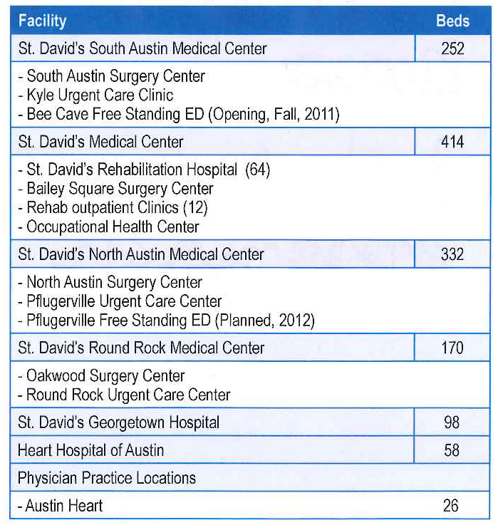
Facilities [P.1a(4)]: 2011 Application
2011 Application
2013 Application
6 acute care hospital campuses & associated services
  St. David’s South Austin Medical Center
  St. David’s Medical Center
  St. David’s North Austin Medical Center
  St. David’s Round Rock Medical Center
  St. David’s Georgetown Hospital
  Heart Hospital of Austin
St. David’s Rehabilitation Hospital
Managed Physician offices
Corporate office

Slide 31
Workforce Groups: SDH
 | 2011 Application | 2013 Application Proposed
Workforce Groups | Employees HCA Staff Physicians (SDHMG, medical staff, referring) Volunteers | Employees Physicians (employed /contract, independent)
Key Workforce Engagement Factors | Employees: Being kept informed Having resources to do job Knowing job uses skills Physicians: Efficient processes Communication Staff competence | Validate with 2012 survey data
Category | Implications
1 | How do you deploy Vision & Mission? How do senior leaders encourage two-way communication? How do you ensure ethical behavior?
2 | How do you obtain & consider input from workforce groups? How do you deploy action plans?
3 | How do you deploy AIDET & service recovery?
4 | How do you make data & information available?
5 | How do you assess capability & capacity needs? How do you onboard? How do you manage performance?
6 | How do you ensure workplace preparedness?
7 | What are your results for satisfaction/engagement, capability/capacity, and workforce development?

Slide 32
Customers & Stakeholders: SDH
Baldrige definition of STAKEHOLDER: All groups that are or might be affected by an organization’s services, actions & success.
 | 2011 Application | 2013 Application Proposed
Key Market Segments | Primary Service Area Secondary Service Area | Service Lines
Key Patient Groups |  | Inpatient Emergency Outpatient Physician Practice
Key Stakeholder Groups | Sponsors/Partners Physicians Community | Community
Key Requirements | Community: Accessibility Contributions to community | Patients Community Same?
Category | Implications
1 | How do you ensure ethical behavior?
2 | How do you systematically obtain & consider input from customers?
3 | How do you listen to them? How do you build relationships with them?
4 | How do you make data & information available?
5 | How do you manage your workforce to reinforce a customer focus?
6 | How do you design processes to meet customer needs?
7 | What are your clinical outcomes? What are your results for satisfaction, engagement, & dissatisfaction?

Slide 33
Suppliers & Partners [P.1b(3)]
Baldrige definition of PARTNERS: Key organizations who are working in concert with your organization to achieve a common goal, typically involving a formal arrangement with a clear understanding of individual/mutual roles
Implications: Deploying MVVG (1.1), ensuring ethical behavior (1.2), strategy development & deployment (Category 2), customer engagement (3.2), data availability (4.2), supply-chain management (6.2), operational effectiveness results (7.1)
 | 2011 Application | 2013 Application Proposed
Suppliers | HPG, Cardinal Health, Hospira, Mid-Line, Bard Medical, Johnson & Johnson, DePuy Orthopaedics | HPG (supplies) HCA (staff)
Partners | Referring physicians | HCA, SDF, Georgetown
Collaborators | ARA, house-based physicians (ED, HIA, Anesthesia) | EMS – To be discussed Other - ?

Slide 34
Key Competitiveness Changes [P.2a(2)]
Implications: Action plan development (2.2), others depending on nature of changes
2011 Application | 2013 Application Proposed
Acquisition of Austin Heart Medical Group (2009) | TBD based on strategic planning retreat
Acquisition of Austin Heart Hospital (2010)
National/state changes in physician & hospital reimbursement
5 new hospitals in PSA

Slide 35
Baldrige – are we improving?
Feedback report summary | 2009 | 2010 | 2011
Process Categories | 4 | 3 | 5
Results | 4 | 2 | 4
Total | 8 | 5 | 9
SDH
SDH

Slide 36
Baldrige – to fulfill the vision, reach higher bands
Process Categories |  |  | Results Categories
4 | Demonstrates effective, systematic approaches responsive to the overall requirements of the criteria, but deployment may vary in some areas or work units. Key processes benefit from fact-based evaluation and improvement, and approaches are being aligned with overall organizational needs |  | 3 | Results address areas of importance to the basic criteria requirements and accomplishment of the organization’s mission with good performance being achieved. Comparative and trend data are available for some of these important results areas, and some beneficial trends are evident.
5 | Demonstrates effective, systematic, well deployed approaches responsive to the overall requirements of most criteria items. The organization demonstrates a fact-based systematic evaluation and improvement process and organizational learning, including innovation, that result in improving the effectiveness and efficiency of key processes. |  | 4 | Results address some key customer/stakeholder, market and process requirements, and they demonstrate good relative performance against relevant comparisons. There are no patterns of adverse trends or poor performance in areas of importance to the overall criteria requirements and the accomplishment of the organization’s mission.
6 | Demonstrates refined approaches responsive to the multiple requirements of the criteria. These approaches are characterized by the use of key measures, good deployment and evidence of innovation in most areas. Organizational learning, including innovation and sharing of best practices, is a key business tool, and integration of approaches with current and future organizational needs is evident. |  | 5 | Results address most key customer/stakeholder, market and process requirements, and they demonstrate areas of strength against relevant comparisons and/or benchmarks. Improvement trends and/or good performance are reported for most areas of importance to the overall criteria requirements and the accomplishment of the organization’s mission.

Slide 37
St. David’s Pursuit
Organizational context
What our pursuit has looked like
Lessons learned
Results

Slide 38
St. David’s Healthcare Executive Summary
Exceptional Care
22% reduction in mortality index
20% reduction in complication index
Top decile performance across all core measures
Decreased ED wait times by an hour and arrival to greet by 50%
Customer Loyalty
Patient satisfaction HCAHPS composite improved from 60% to 75.8% (national top 25%)
Employee engagement at 83% (highest in HCA)
Physician engagement – (Highest in PRC database)
Financial Strength
15% CAGR in gross revenue
13% CAGR in EBITDA
$780M in capital investment with no debt
24% operating margin
Growth – sustainability
5% admissions growth
3% Rehab admits
6% growth in deliveries
4% growth in inpatient surgeries
3% growth in outpatient surgeries
10% growth in ED visits

Slide 39
Honors and accolades
St. David’s HealthCare

Slide 40

NAMED “15 Top Health System” in 2012
Top five large, medium, and small health systems recognized by Thomson Reuters, NOW Truven Health Analytics
  HCA Central and West Texas Division named in medium category
    St. David’s HealthCare (Austin)
    Las Palmas Del Sol Healthcare (El Paso)
Selected from 321 health systems in US
  The “15 Top Health Systems” along with 49 other health systems represent the top quintile of the 321 systems in the study
Only system recognized from Central Texas
One of two health systems in Texas to receive designation

Slide 41
“15 Top Health Systems” PERFORMANCE MEASURES
Recognition based on eight performance measures of quality, safety, efficiency and consumer satisfaction:
  Risk-adjusted mortality index (in-hospital)
  Risk-adjusted complications index
  Risk-adjusted patient safety index
  Core measures mean percent
  30-day risk-adjusted mortality rate
  30-day risk-adjusted readmission rate
  Severity-adjusted average length of stay
  Inpatient patient satisfaction score (patient rating of overall hospital performance)
Notable Top Quintile Health Systems:
  Baylor Health Care System – Dallas, TX
  Mayo Foundation – Rochester, MN
  Methodist Hospital System – Houston, TX
  Partners HealthCare – Boston, MA
  Ochsner Health System – New Orleans, LA
  Scott & White Healthcare – Temple, TX
  Scripps Health – San Diego, CA

Slide 42

Other Recognitions
Truven Health (Thomsen Reuters) “100 Top Hospitals”
  Four SDH hospitals* recognized in 2012, two in 2013
  SDMC ranked for four consecutive years
  SDNAMC ranked for two consecutive years
Truven Health (Thomsen Reuters) “Top 50 Cardiovascular Hospitals”
  HHA, seven year recipient
Joint Commission “Top Performer of Key Quality Measures”
  Three SDH hospitals recognized as Top Performers in 2012
  SDNAMC recognized for two consecutive years
Texas Medical Foundation “Texas Healthcare Quality Improvement Award”
  Four SDH hospitals recognized with Silver Quality Improvement Award in 2012
U.S. News & World Report “Best Hospitals”
  SDNAMC: “High Performer” in nephrology, neurology & neurosurgery
  SDSAMC: “High Performer” in nephrology
American Heart Association “Mission Lifeline”
  SDNAMC: Silver Level Recognition
  HHA: Bronze Level Recognition
  SDRRMC: Bronze Level Recognition
* St. David’s Medical Center, St. David’s North Austin Medical Center, St. David’s Round Rock Medical Center and St. David’s Georgetown Hospital (A Facility of St. David’s Medical Center)
Notes:
41

Slide 43


Other Recognitions
HealthGrades
  SDMC received 14 Quality Awards in 2012 (most in Central Texas)
    “Distinguished Hospital Award for Clinical Excellence
    (Top 5% in US)
    Top 5% in US for Neurosciences, Neurosurgery, Stroke,
    Pulmonary Care, and Maternity Care
    Top 10% in US for GYN surgery
    5-Star Ratings in 12 clinical areas
  SDSAMC received two Excellence Awards (Cardiac Surgery, Maternity Care)
    5-Star Ratings in four clinical areas
  SDNAMC received six Quality Awards
    Top 5% in US for General Surgery, GI Medical and Overall GI Services
    Ranked in Top 10% in US for Prostatectomy
    5-Star Ratings in 10 clinical areas
  SDRRMC received 5-Star Ratings in three clinical areas
  HHA received Pulmonary Care Excellence award for 3rd consecutive year
    Top 10% in U.S. for Overall Pulmonary Services for 3rd consecutive year
    5-Star rating in Valve Surgery and Heart Failure
Notes:
42

Slide 44



Other Recognitions
Consumer Reports “Safest Hospitals”
  SDMC recognized as 2nd “Safest Hospital in Texas”
  SDNAMC ranked 9th “Safest Hospital in Texas”
The Leapfrog Group “Hospital Safety Score”
  All but one facility received Grade A Ratings
UnitedHealth “Premium Cardiac Services” Recognition
  SDSAMC: Specialty Center for Rhythm Management, Cardiac Surgery, and Interventional Cardiac Care
  HHA: Premium Cardiac Specialty Center®
Aetna “Institute of Quality Cardiac Care” – HHA
Blue Cross Blue Shield “Blue Distinction Center for Cardiac” – HHA
Quality Texas Foundation “Texas Award for Performance Excellence”
  Highest honor bestowed by the State of Texas (analogous to Governor’s Award)
  Based on Malcolm Baldrige National Quality Criteria
Austin Business Journal “Best Places to Work”
  #1 Best Place to Work in Central Texas for 3 Consecutive Years (2007 – 2009)
Texas Workforce Commission “Texas Employer of the Year”
  1st health system in Texas to be named “Texas Employer of the Year”
* St. David’s Medical Center, St. David’s North Austin Medical Center, St. David’s Round Rock Medical Center and St. David’s Georgetown Hospital (A Facility of St. David’s Medical Center)
Notes:
43

Slide 45
Community Benefit
St. David’s Foundation

Slide 46






Grant partners of the St. David’s Foundation (65 Entities / 74 grants)
Healthy Aging
Healthy Living
Austin Groups for the Elderly • Austin Speech Labs • Capital Area Food Banks of Texas • The Care Communities • Combined Community Action • Faith in Action Caregivers • Family Eldercare • Hospice Austin • Meals on Wheels and More • New Connections • Texas Ramp Project • Round Rock Area Serving Center • Williamson-Burnet County Opportunities
Boys & Girls Clubs • Friends of Public Health • Marathon Kids • YMCA (MEND program)
Healthy Minds
Healthy Smiles
Any Baby Can • Austin Child Guidance Center • Austin Recovery • Austin Travis County Integral Care • Capital Area Counseling • Community Schools • El Buen Samaritano • Family Crisis Center • Hays-Caldwell Women's Center • Interagency Support Council of East Williamson County • Leander ISD • LifeWorks • Lone Star Circle of Care • People's Community Clinic • SafePlace • SIMS Foundation • Waterloo Counseling • Wonders and Worries • YWCA Greater Austin
Austin ISD • Del Valle ISD • Hays Consolidated ISD • Manor ISD • Pflugerville ISD • Round Rock ISD • Austin District Dental Hygienists' Society • Ben White Clinic (Lone Star & CommuniCare) • Capital Area Dental Society • Capital Area Dental Foundation • Children's Wellness Center-Del Valle • CommuniCare-Kyle • CommUnityCare • El Buen Samaritano
Hays WELL Clinic • Health Alliance for Austin Musicians • Lone Star Circle of Care (Round Rock & Georgetown) • People's Community Clinic • Volunteer Health Clinic
Healthy People
Any Baby Can • AIDS Services of Austin • Breast Cancer Resource Center • Cancer Connection • CommuniCare-Kyle • Community Health Center of South Central Texas-Luling • Easter Seals-Central Texas • El Buen Samaritano • Lone Star Circle of Care • Manos de Cristo Dental Clinic • People's Community Clinic • Samaritan Health Ministries • Tandem Project • U.T. School of Nursing • Volunteer Healthcare Clinic
Healthy Futures
Austin Community College • Capital IDEA • Concordia University • Texas State University School of Nursing

Slide 47
Strong and growing contributions to the community
Approximately $175 Million in Community Grants since Formation of the Foundation in 1996
$39M
(projected)
$34M
$25M
$18M
$13M
$9M
$6M
$3M
2005
2006
2007
2008
2009
2010
2011
2012
Notes:
HOW MANY PROGRAMS DO THEY SUPPORT? HOW MUCH TO COMMUNITY IN TOTAL SINCE PARTNERSHIP ESTABLISHED?
Texas State University School of Nursing
UT School of Nursing
Endowment for Health Care for Underserved Populations
Family and Children’s Wellness Centers
Expand Nurse Practitioners Training Programs
Austin Community College Endowment for Scholarships
Capital IDEA Nursing Students
Concordia University School of Nursing
Texas A&M University Health Science Center
St. David’s Neal Kocurek Scholarships

Slide 48
$30.9 Million in Community Grants in 2011
(Low-Income Elderly)
(Behavioral Health)
(Primary and Specialty Care for Under- and Un-Insured)
(Health Education
& Research)
(Free Pedi Dental Care)
(Health & Wellness)
Notes:
INSERT HEALTHY SLIDE BACK IN WITH TOTAL OVER TIME ACROSS TOP

Slide 49
The pursuit continues
To be the finest care and service organization in the world
We are still learning, improving, refining….
But in the end, it will be the patients and families we serve…..
It will be the community….
Employers, families, and even regulatory bodies…
It will be the physicians who practice medicine…..
It will be the staff who tirelessly contribute their time and talent…..
Who will tell us if we are there or not…..

Slide 50
Thank you

